Slide 1
Smart parking with bluetooth controller rc car

Slide 2
Our team
Ahmed Abdelazeem
Abdelrahman Khaled
Karem Atef
Eslam Nabiel
Esraa Ibrahim
Hager Mohamed

Slide 3
Introduction
This is an Arduino based Bluetooth controlled RC car.
• It is controlled by a smart phone application.
• Bluetooth controlled car is controlled by using Android mobile phone instead of any other method like buttons, gesture etc.
• Here only needs to touch button in android phone to control the car, where android phone is used as transmitting device and Bluetooth module placed in car is used as receiver.
• Android phone transmits command using its built-in Bluetooth to car so that it can move in the required direction like moving forward, reverse, turning left, turning right and stop.

Slide 4
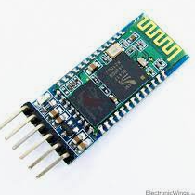
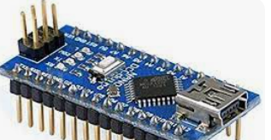
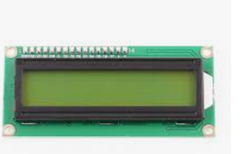
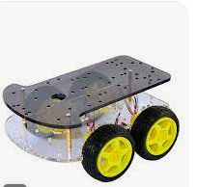
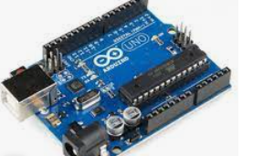
Components
Arduino uno
Arduino nano
Bluetooth modules HC_05
Motor drive shield
2 Dc motor(12V)
Car Kit
Remote control
IR sensor
Lcd
Potentiometer
Battary (9V)
Jumpers
2 bridboard
Weels (2x)
2 Servo motor
Li-ion battery (3.7V)

Slide 5
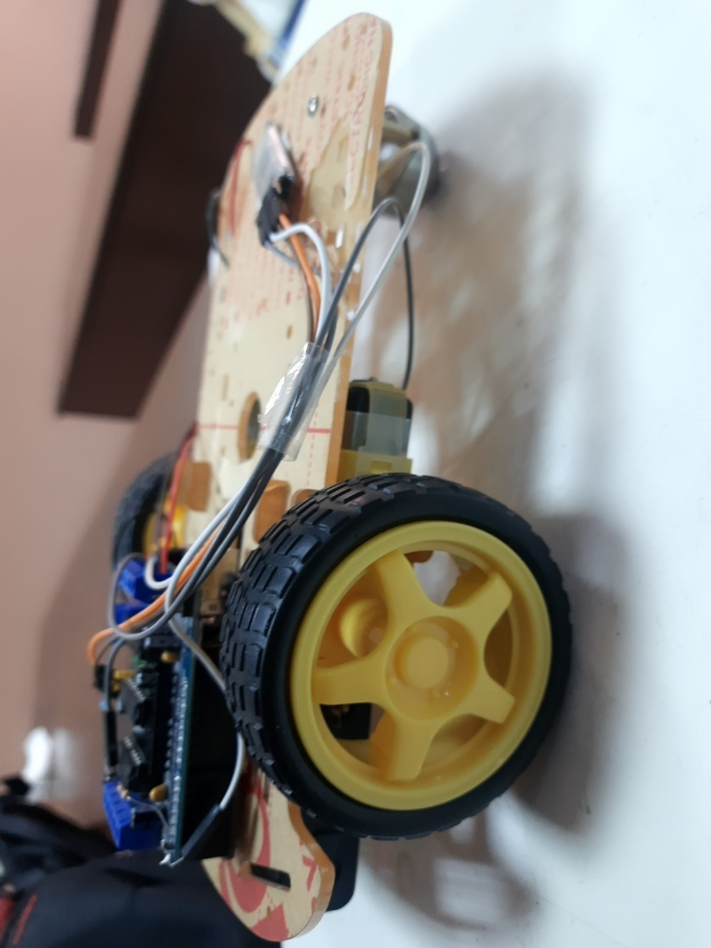
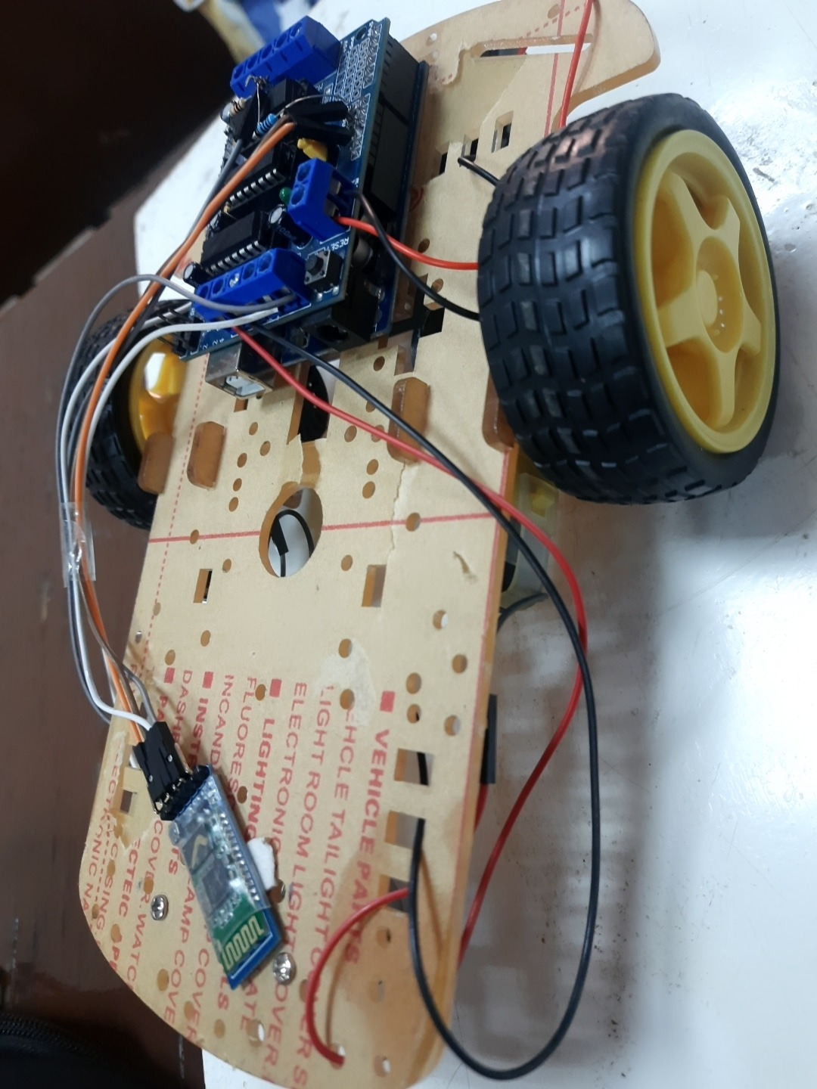
Bluetooth Controlled Car

Slide 6
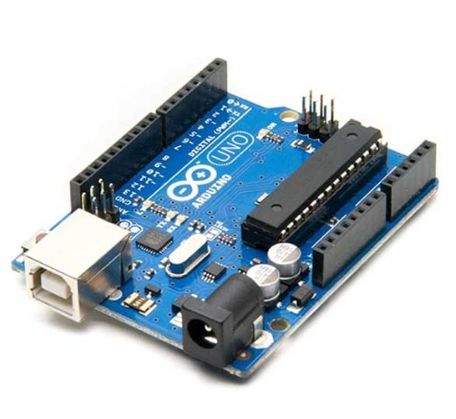
Arduino uno
The Arduino Uno is an open-source microcontroller board based on the Microchip ATmega328P microcontroller.
The board is equipped with sets of digital and Analog input/output pins that may be interfaced to various expansion boards and other circuits. The board has 14 digital I/O pins , 6 Analog I/O pins, and is programmable with the Arduino IDE , via a type B USB cable. It can be powered by the USB cable or by an external 9-volt battery, though it accepts voltages between 7- 20 volts.

Slide 7
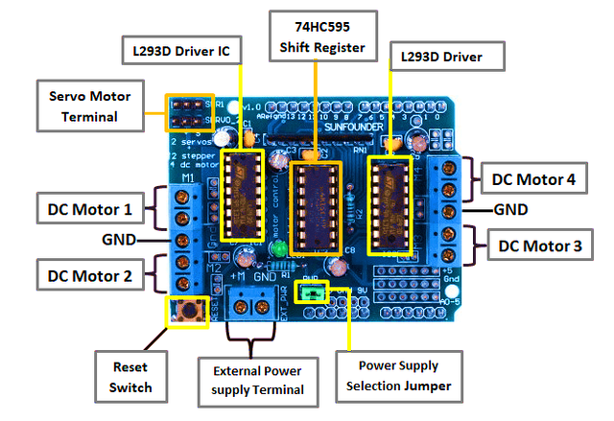
Structure of the L293D motor driver shield
each channel of this module has the maximum current of 1.2A and doesn’t work if the voltage is more than 25v or less than 4.5v.
The L293D is a dual-channel H-Bridge motor driver capable of driving a pair of DC motors or single stepper motor. This shield offers total four H-Bridges and each H-bridge can deliver up to 0.6A to the motor.

Slide 8
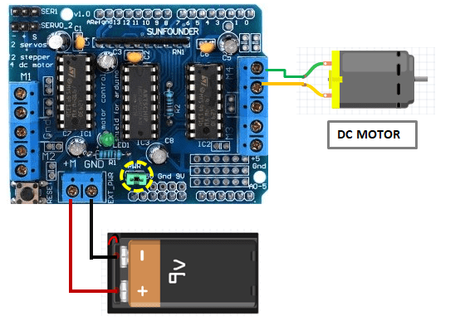
Controlling motors using the L293D motor driver shield and Arduino
Before using the L293D motor driver shield with Arduino IDE, we need to install the AFMotor.h library. This contains the commands to control DC, stepper and servo motors.
Driving DC Motors.
This motor shield can drive DC motors having voltages between 4.5 to 25V. We are using DC Motors that are rated for 9V. So, we will connect external 9V power supply to the EXT_PWR terminal
The motor is connected to any of M1, M2, M3 or M4 motor terminals. In this case, Arduino pin11 for M1, pin3 for M2, pin5 for M3, pin6 for M4 and pins 4, 7, 8 and 12 are all in use

Slide 9
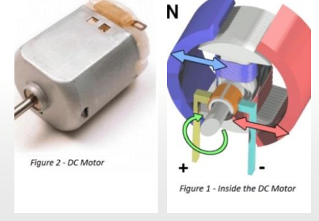
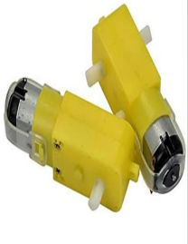
DC MOTOR
A Direct Current (DC) motor is a rotating electrical device that converts direct current, of electrical energy, into mechanical energy. An Inductor (coil) inside the DC motor produces a magnetic field that creates rotary motion as DC voltage is applied to its terminal. Inside the motor is an iron shaft, wrapped in a coil of wire. This shaft contains two fixed, North and South, magnets on both sides which causes both a repulsive and attractive force, in turn, producing torque
GEAR MOTOR
• A gear motor is an all-in-one combination of a motor and gearbox.
• The addition of a gear head to a motor reduces the speed while increasing the torque output. • The most important parameters in regards to gear motors are speed (rpm), torque (lb-in) and efficiency (%).

Slide 10
Bluetooth Module
B l u e t o o t h M o d u l e u s e d i n T h i s p r o j e c t i s t h e H C - 0 5 a n d i t i s a w i r e l e s s c o m m u n i c a t i o n p r o t o c o l ; i t i s u s e d i n t w o d e v i c e s a s a s e n d i n g a n d r e c e i v i n g t h e i n f o r m a t i o n . T h e B l u e t o o t h i s f r e e t o u s e i n t h e w i r e l e s s c o m m u n i c a t i o n p r o t o c o l a s t h e r a n g e o f t h e B l u e t o o t h i s l e s s t h a n t h e o t h e r w i r e l e s s c o m m u n i c a t i o n p r o t o c o l s l i k e W i - F i a n d Z i g b e e .
W e c a n u s e i t w i t h m o s t m i c r o c o n t r o l l e r s . B e c a u s e i t o p e r a t e s S S P ( S e r i a l P o r t P r o t o c o l). T h e m o d u l e c o m m u n i c a t e w i t h t h e h e l p o f U S A R T ( U n i v e r s a l S y n c h r o n o u s / A s y n c h r o n o u s R e c e i v e r / T r a n s m i t t e r ) a t t h e b a u d r a t e o f 9600 .
T h e B l u e t o o t h o p e r a t e s a t t h e 2 . 4 5 G H z f r e q u e n c y b a n d . T h e t r a n s f e r r a t e o f t h e d a t a c a n v a r y u p t o 1 M b p s a n d i s i n r a n g e o f 1 0 m e t e r s . T h e H C - 0 5 m o d u l e c a n b e o p e r a t e d w i t h i n 4 - 6 V o f p o w e r s u p p l y .
I t s u p p o r t s b a u d r a t e o f 9 6 0 0 , 1 9 2 0 0 , 3 8 4 0 0 , 57600 , e t c .
M o s t i m p o r t a n t l y i t c a n b e o p e r a t e d i n M a s t e r - S l a v e m o d e w h i c h m e a n s i t w i l l n e i t h e r s e n d o r r e c e i v e d a t a f r o m e x t e r n a l s o u r c e s .

Slide 11
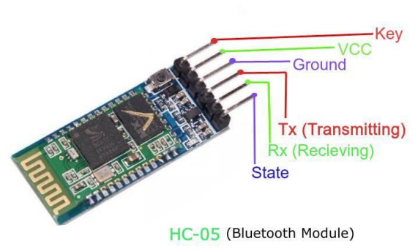
Bluetooth Module
E n a b l e - T h i s p i n i s u s e d t o s e t t h e D a t a M o d e o r a n d A T c o m m a n d m o d e ( s e t h i g h ) .
V C C - T h i s i s c o n n e c t e d t o + 5 V p o w e r s u p p l y .
G r o u n d - C o n n e c t e d t o g r o u n d o f p o w e r i n g s y s t e m .
T x ( T r a n s m i t t e r ) - T h i s p i n t r a n s m i t s t h e r e c e i v e d da t a S e r i a l l y
R x ( R e c e i v e r ) - U s e d f o r b r o a d c a s t i n g d a t a s e r i a l l y o v e r b l u e t o o t h
S t a t e - U s e d t o c h e c k i f t h e b l u e t o o t h i s w o r k i n g p r o p e r l y .
Connecting Arduino with HC -05 :
Vcc → 5v
Gnd → Gnd
Rx → Tx (Arduino)
Tx → Rx (Arduino)
Note: Tx of Arduino is connected to Rx of module through a resistor voltage divider which is provided for converting 5v logic signal sent by Arduino to +3.3v logic signals which are suitable for the module

Slide 12
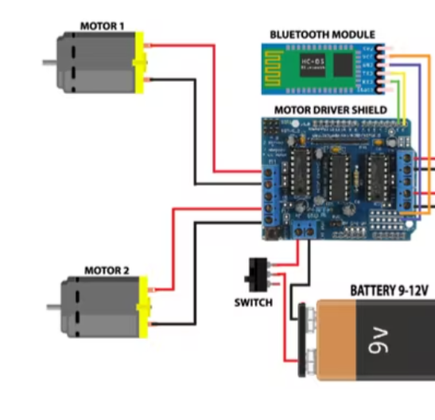
Circuit for car

Slide 13
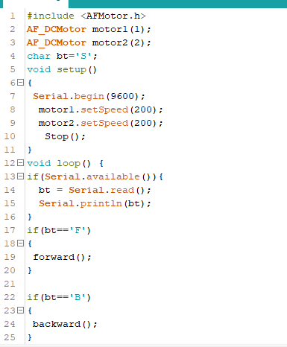
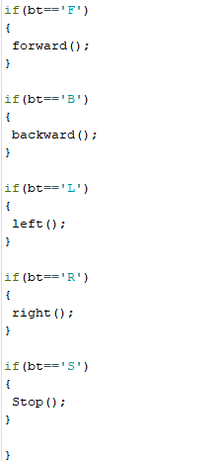
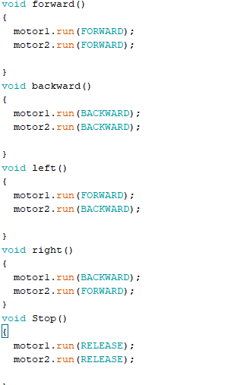
Code for car

Slide 14
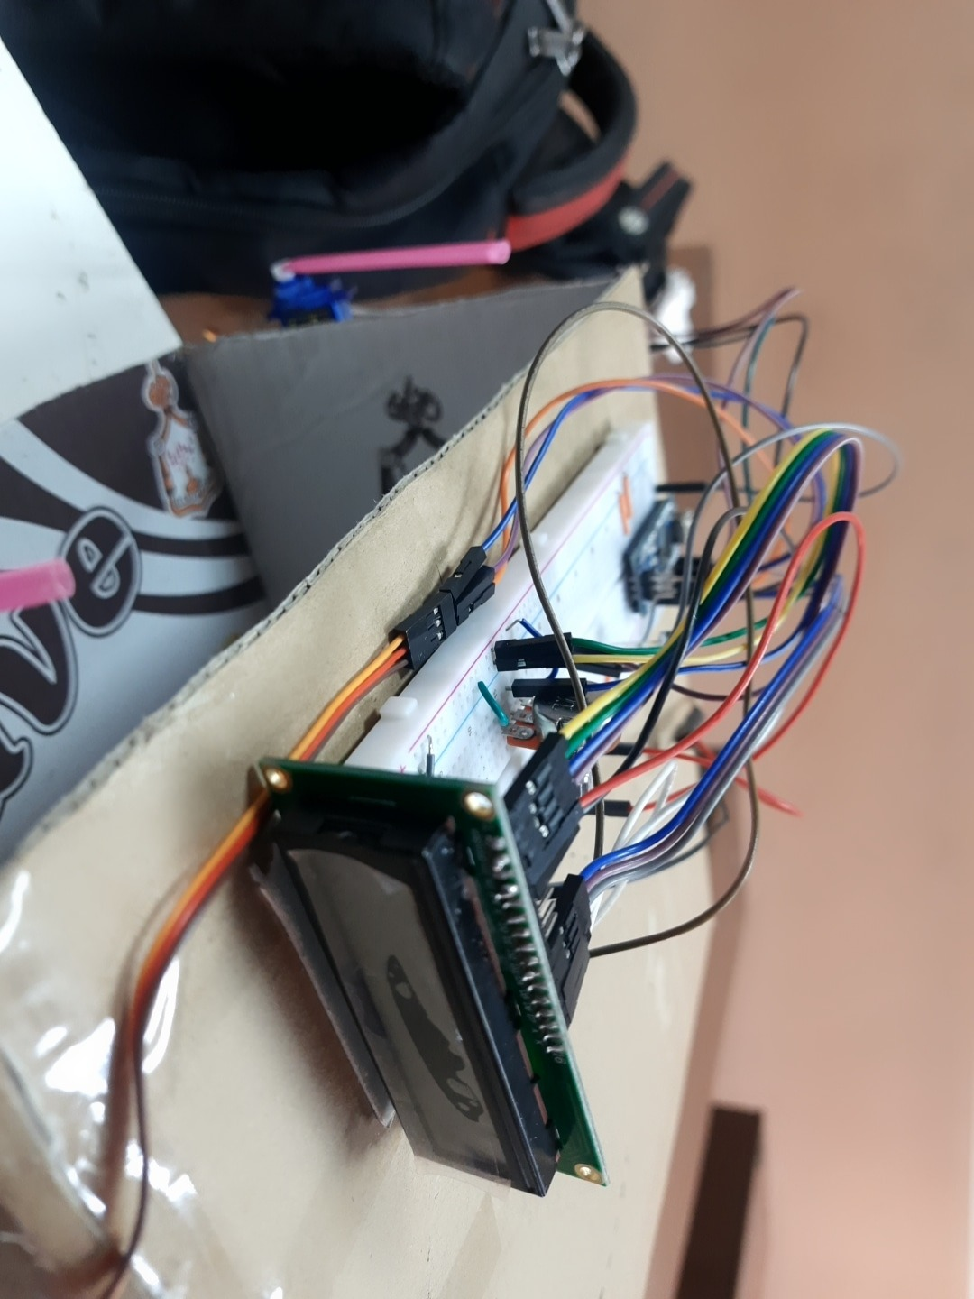
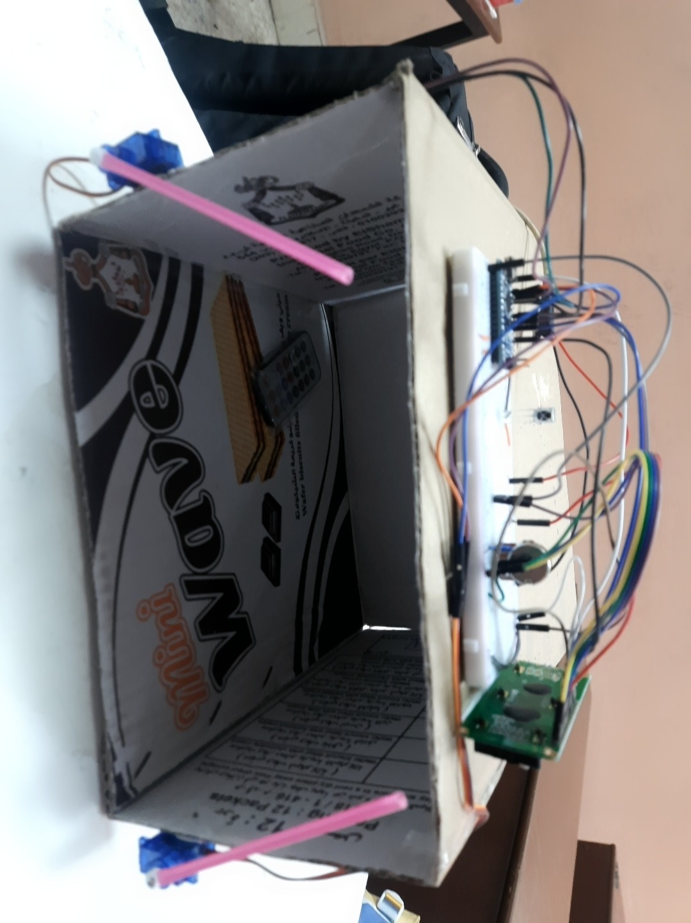
Smart parking

Slide 15
Arduino nano
The Arduino Nano can be powered via the Mini-B USB connection, 6-20V unregulated external power supply (pin 30), or 5V regulated external power supply (pin 27). The power source is automatically selected to the highest voltage source.
Each of the 14 digital pins on the Nano can be used as an input or output, using pinMode(), digitalWrite(), and digitalRead() functions. They operate at 5 volts. Each pin can provide or receive a maximum of 40 mA.
In addition, some pins have specialized functions:
Serial: 0 (RX) and 1 (TX). Used to receive (RX) and transmit (TX) TTL serial data. These pins are connected to the corresponding pins of the FTDI USB-to-TTL Serial chip.
External Interrupts: 2 and 3. These pins can be configured to trigger an interrupt on a low value, a rising or falling edge, or a change in value. See the attachInterrupt() function for details.
PWM: 3, 5, 6, 9, 10, and 11. Provide 8-bit PWM output with the analogWrite() function.
SPI: 10 (SS), 11 (MOSI), 12 (MISO), 13 (SCK). These pins support SPI communication, which, although provided by the underlying hardware, is not currently included in the Arduino language.
LED: 13. There is a built-in LED connected to digital pin 13. When the pin is HIGH value, the LED is on, when the pin is LOW, it's off.

Slide 16
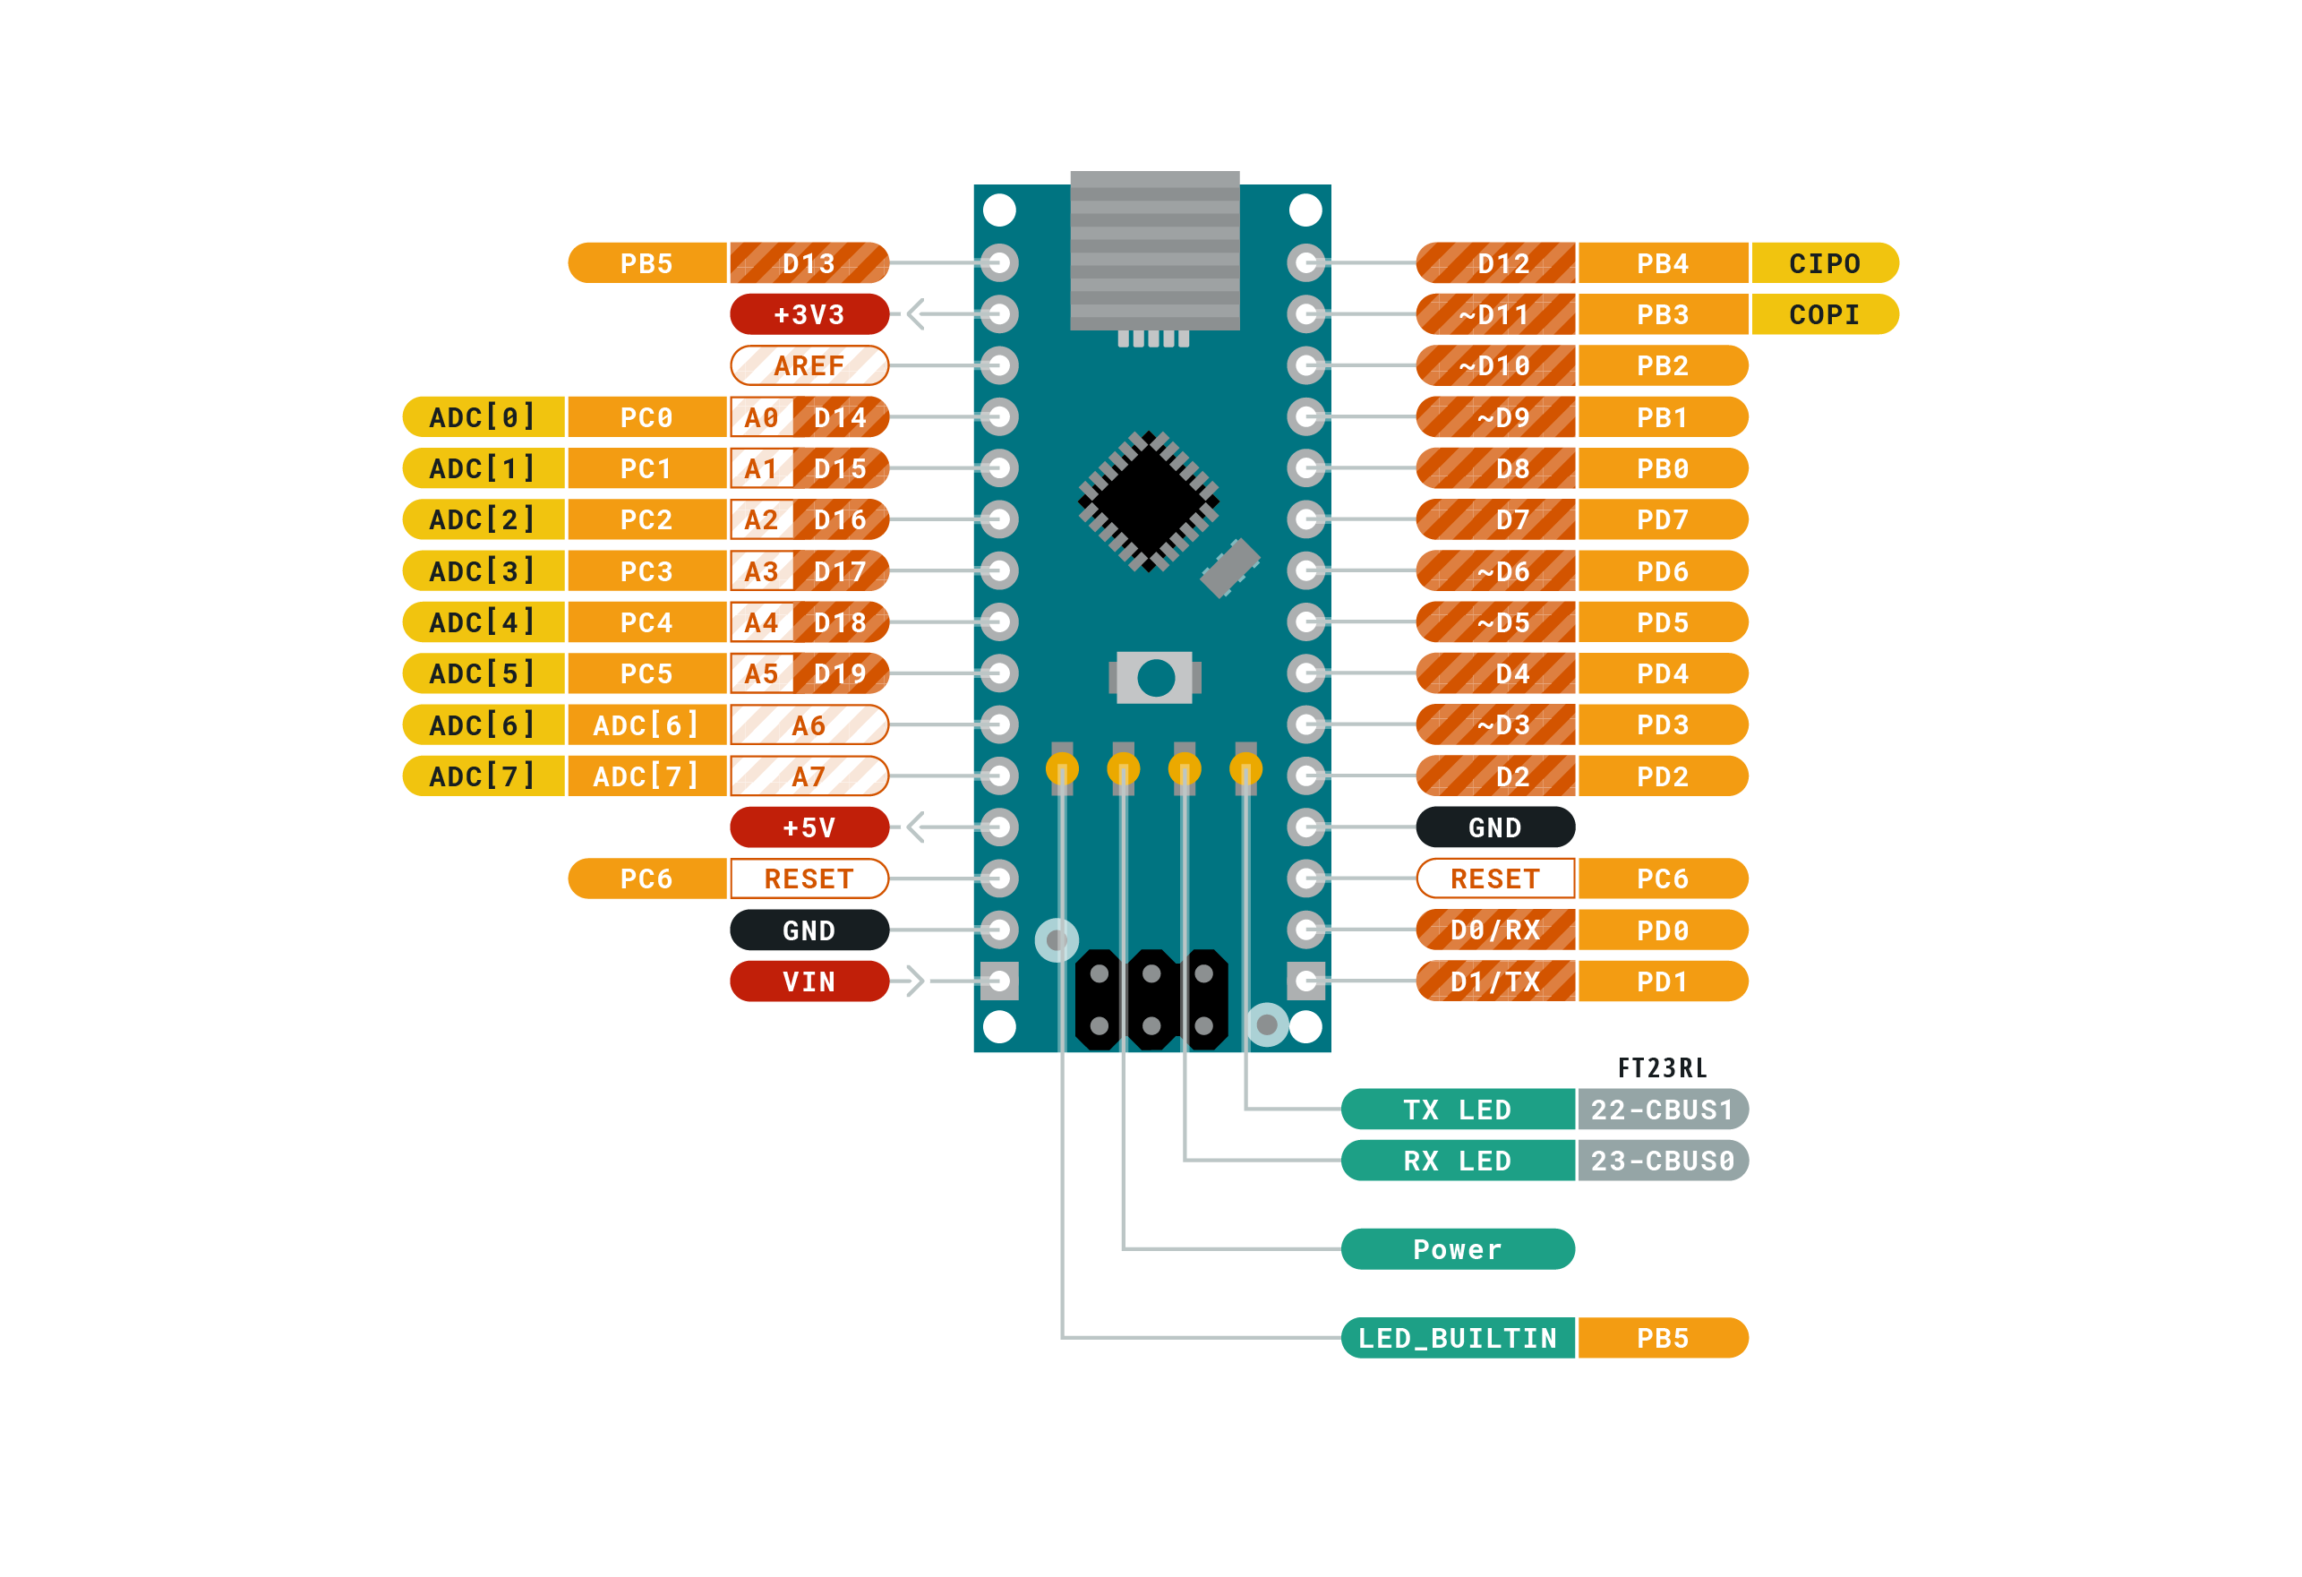
Arduino nano
The Nano has 8 analog inputs, each of which provide 10 bits of resolution (i.e. 1024 different values). By default they measure from ground to 5 volts, though is it possible to change the upper end of their range using the analogReference() function. Analog pins 6 and 7 cannot be used as digital pins

Slide 17
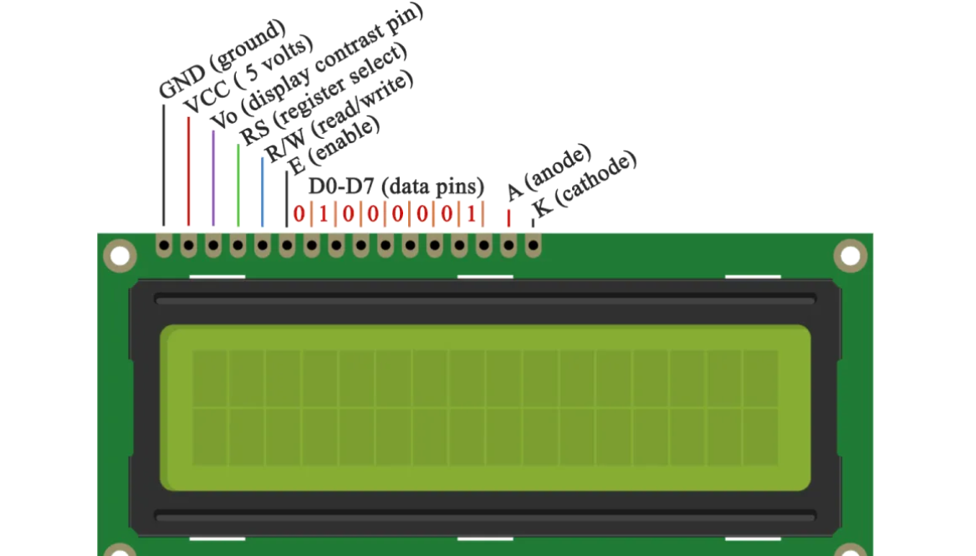
lcd
16×2 LCD Pinout
It has 16 pins and the first one from left to right is the Ground pin.
The second pin is the VCC which we connect the 5 volts pin on the Arduino Board.
Next is the Vo pin on which we can attach a potentiometer for controlling the contrast of the display.
Next, The RS pin or register select pin is used for selecting whether we will send commands or data to the LCD. For example if the RS pin is set on low state or zero volts, then we are sending commands to the LCD like: set the cursor to a specific location, clear the display, turn off the display and so on. And when RS pin is set on High state or 5 volts we are sending data or characters to the LCD.
Next comes the R/W pin which selects the mode whether we will read or write to the LCD. Here the write mode is obvious and it is used for writing or sending commands and data to the LCD.

Slide 18
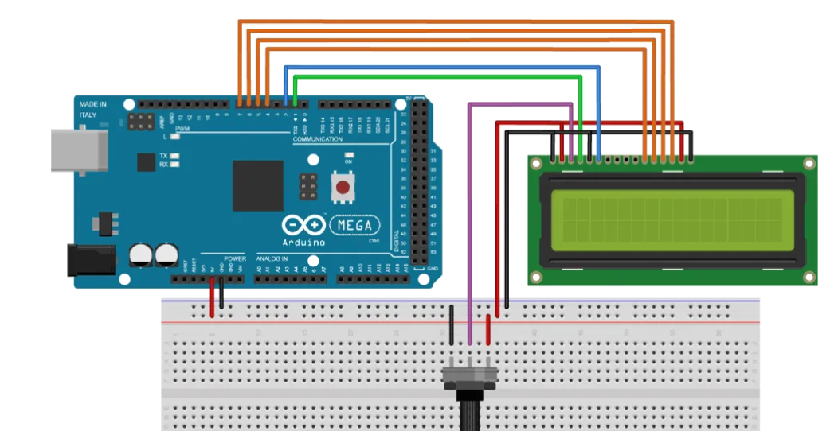
lcd
Next is the E pin which enables the writing to the registers.
the next 8 data pins from D0 to D7. So through this pins we are sending the 8 bits data when we are writing to the registers or for example if we want to see the latter uppercase A on the display we will send 0100 0001 to the registers according to the ASCII table.
The last two pins A and K, or anode and cathode are for the LED back light.

Slide 19
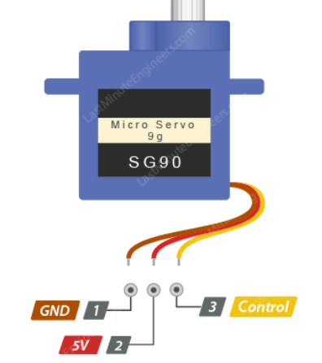
servo motor
Servo motors have three wires: power, ground, and signal. The power wire is typically red, and should be connected to the 5V pin on the Arduino board. The ground wire is typically black or brown and should be connected to a ground pin on the board. The signal pin is typically yellow or orange and should be connected to PWM pin on the board.
#include <Servo.h>
Servo myservo; // create servo object to control a servo
myservo.attach(9); // attaches the servo on pin 9 to the servo object
myservo.write(angle);

Slide 20
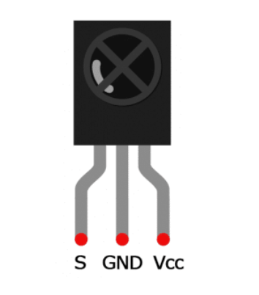
IR Protocol
IR or infrared communication is one of the most common methods of wireless communication due to being easy to use and having an affordable price. Infrared light, with a wavelength longer than visible light, is not within the range of human vision. That’s why it’s a good option for wireless communications. When you press a button on your TV control, an LED on your control turns on and off continuously and causes a modulated infrared signal to send from the control to your TV. The command will execute after the signal is demodulated. IR receiver modules are used to receive IR signals. These modules work in 3, 8 KHz frequency. When the sensor is not exposed to any light at its working frequency, the Vout output has a value equal to VS (power supply). With exposing to a 38 kHz infrared light, this output will be zero.
These modules have 3 pins for Vout, VDD, and Ground so it’s very easy to use them in circuits.

Slide 21
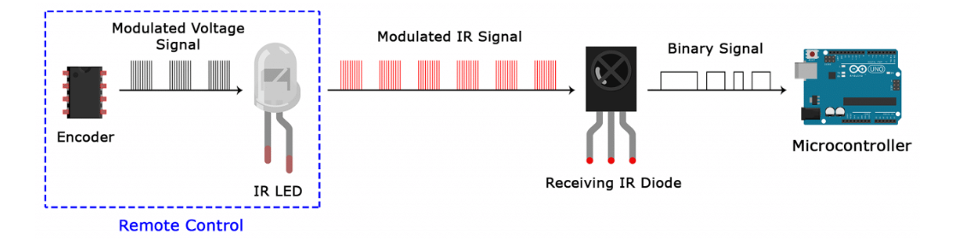
IR SIGNAL MODULATION
In IR signal modulation, an encoder on the IR remote converts a binary signal into a modulated electrical signal. This electrical signal is sent to the transmitting LED. The transmitting LED converts the modulated electrical signal into a modulated IR light signal. The IR receiver then demodulates the IR light signal and converts it back to binary before passing on the information to a microcontroller:
The modulated IR signal is a series of IR light pulses switched on and off at a high frequency known as the carrier frequency. The carrier frequency used by most transmitters is 38 kHz, because it is rare in nature and thus can be distinguished from ambient noise. This way the IR receiver will know that the 38 kHz signal was sent from the transmitter and not picked up from the surrounding environment.
The receiver diode detects all frequencies of IR light, but it has a band-pass filter and only lets through IR at 38 kHz. It then amplifies the modulated signal with a pre-amplifier and converts it to a binary signal before sending it to a microcontroller.

Slide 22
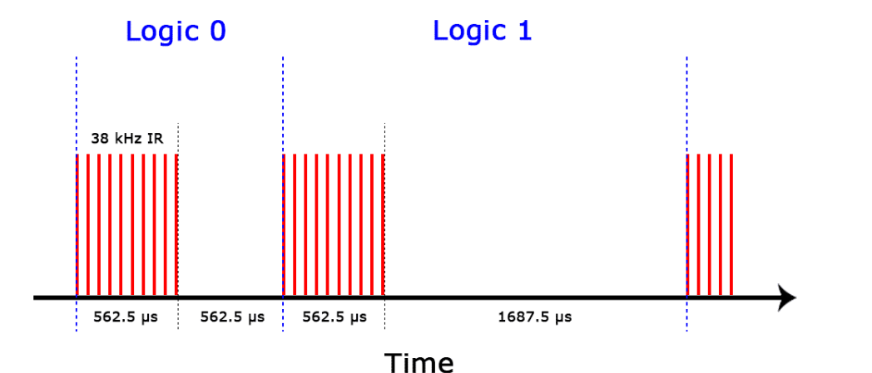
IR TRANSMISSION PROTOCOLS
The pattern in which the modulated IR signal is converted to binary is defined by a transmission protocol. There are many IR transmission protocols. Sony, Matsushita, NEC, and RC5 are some of the more common protocols.
The NEC protocol is also the most common type in Arduino projects, so I’ll use it as an example to show you how the receiver converts the modulated IR signal to a binary one.
Logical ‘1’ starts with a 562.5 µs long HIGH pulse of 38 kHz IR followed by a 1,687.5 µs long LOW pulse. Logical ‘0’ is transmitted with a 562.5 µs long HIGH pulse followed by a 562.5 µs long LOW pulse:
This is how the NEC protocol encodes and decodes the binary data into a modulated signal. Other protocols differ only in the duration of the individual HIGH and LOW pulses.

Slide 23
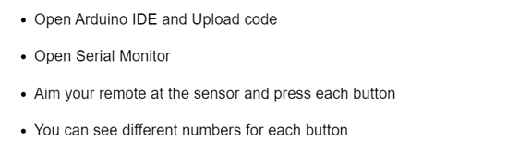
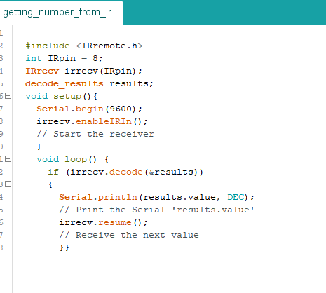
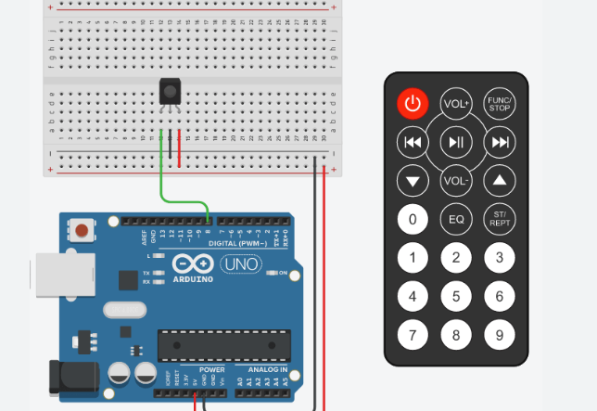
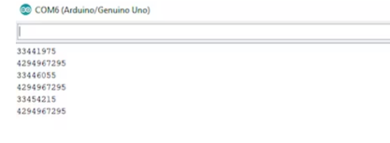
Code for ir

Slide 24
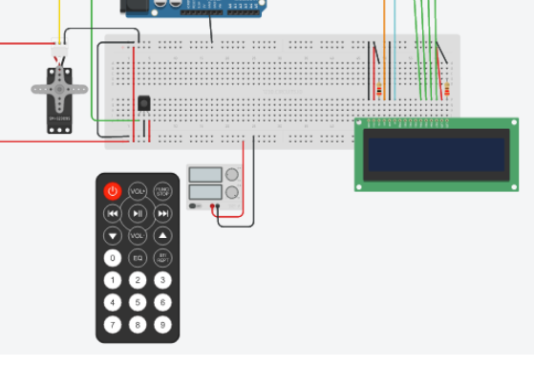
Circuit for parking

Slide 25
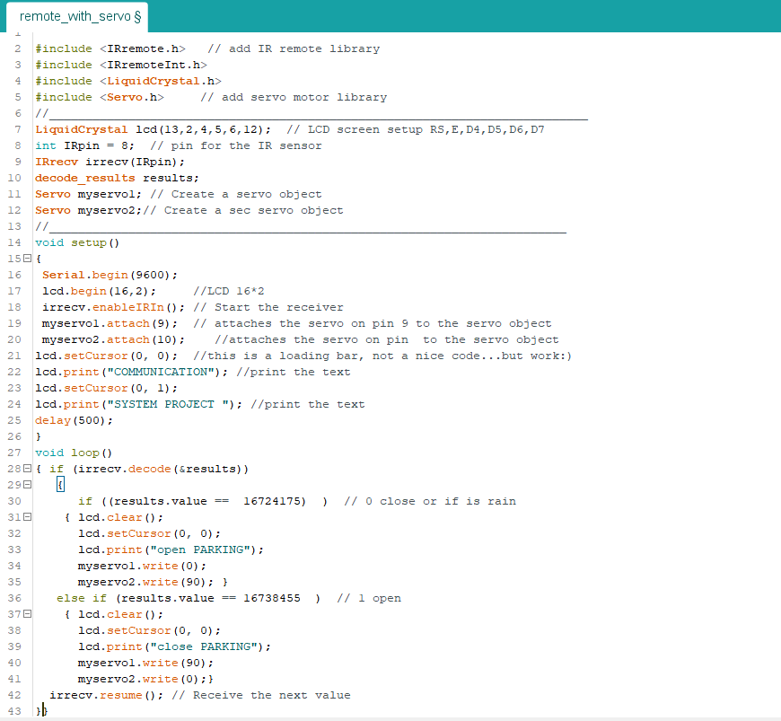
Code for parking

Slide 26
THANK YOU

